Slide 1


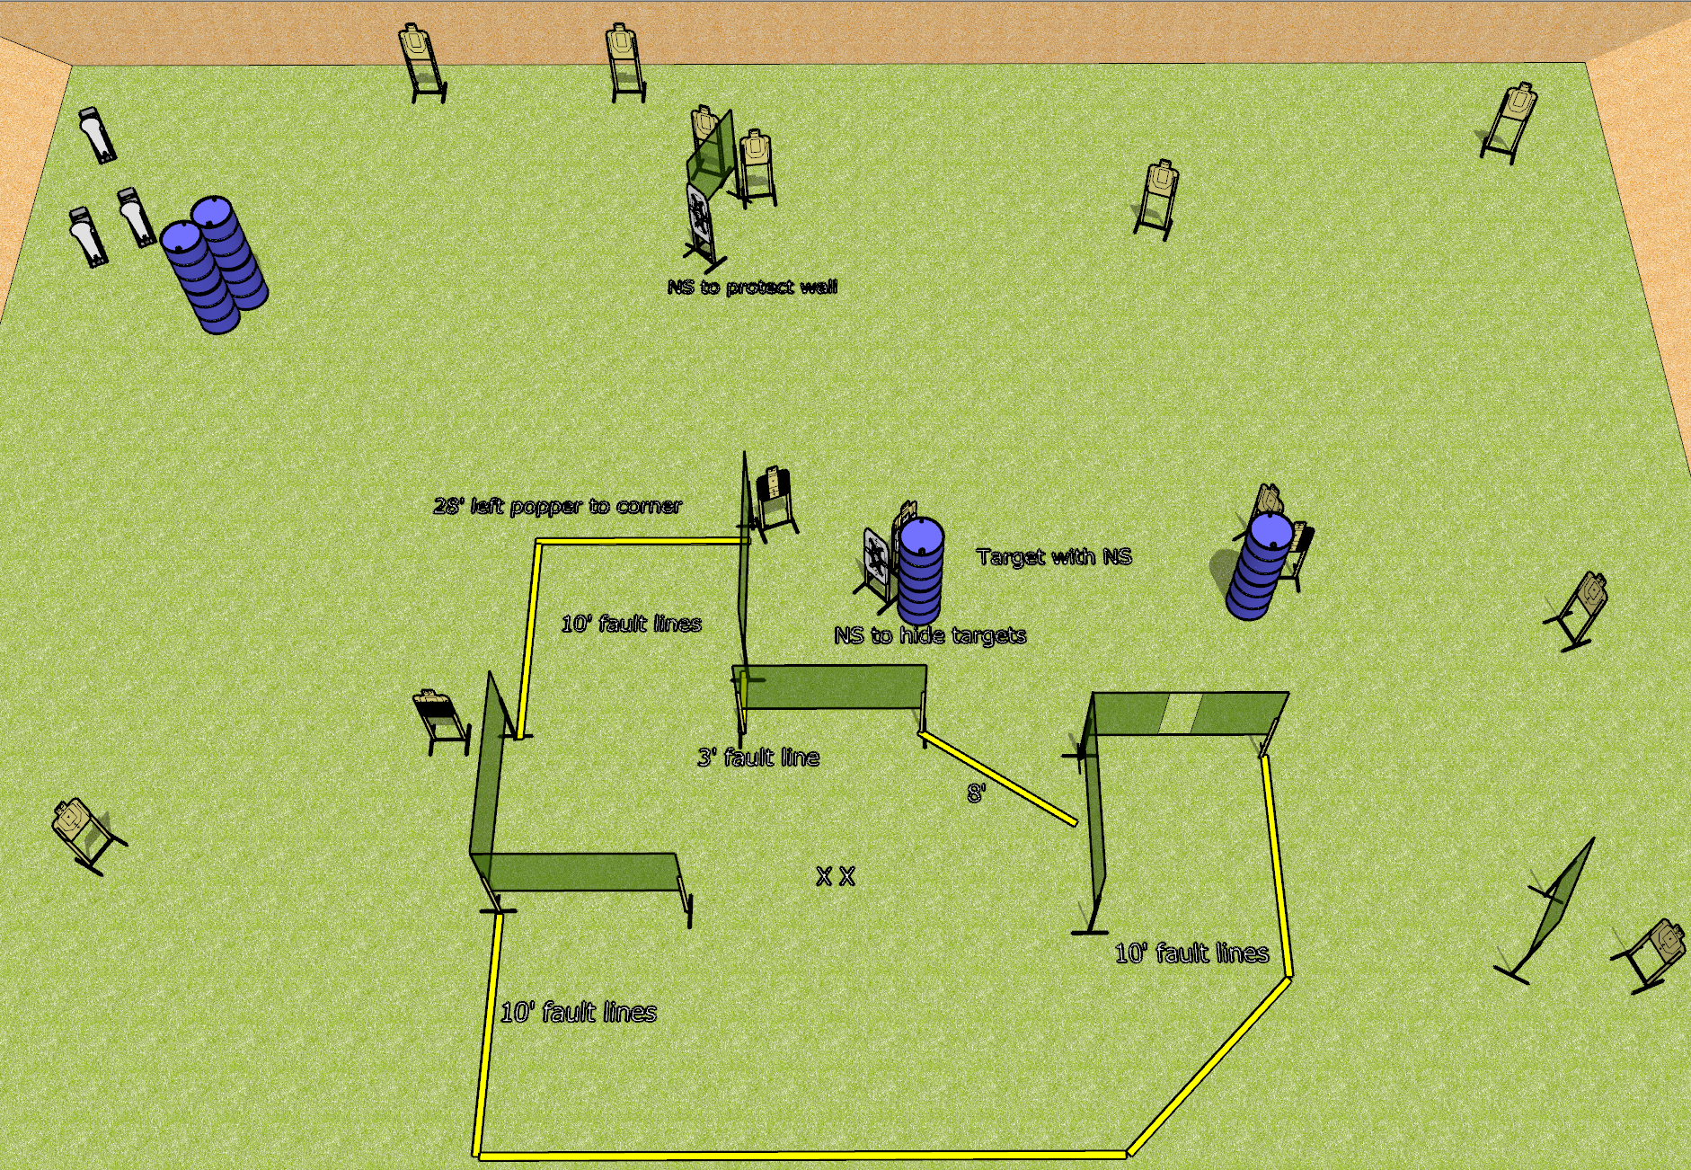
 | Dothan Gun Club – USPSA Match Why the Middle Course Designer : Drew Coleman
Round Count 31 rounds 14 USPSA 3 colt poppers
Equipment List 14 wall feet 2 tux, 1 50% 11 targets (10 + 1 NS), 3-4 NS targets for walls/blocking

Slide 2
Why the Middle
Written Stage Briefing
Scoring: Comstock
Rounds: 31
Targets: 14 USPSA, 3 steel
Handgun start position: both feet on X’s, wrists below belt. Handgun is loaded and holstered.
PCC start position: both feet on X’s, stock on belt. Loaded carbine is held with both hands, safety on.
Stage Procedure: on the audible start signal, engage targets as they become available from within the shooting area.

